Slide 1
Bitwise Operations
CS580U – Spring 2019

Slide 2
What is Binary
Recall - Every thing in a computer is binary
Text
images
video
this slide lecture

Slide 3
Why Binary?
Why do computers use binary?
Why not base 10?
Why do we use a decimal system?

Slide 4
Counting Binary
Computers are built out of switches with two states
On
Off
Computers only have two fingers

Slide 5
How Does Binary Work?
Base 2
0 and 1
2 (in base 10) == 10 (in base 2)
Binary Powers of two:
1 | 2 | 4 | 8 | 16 | 32 | 64 | 128
0000 0001 | 0000 0010 | 0000 0100 | 0000 1000 | 0001 0000 | 0010 0000 | 0100 0000 | 1000 0000

Slide 6
Translate from Binary to Decimal
Each place is a power of two
Just like each place in decimal is a power of ten
1000, 100, 10, 1
Count the places, and add them up
8, 4, 2, 1
1010 = 1*2³ + 0*2² + 0*2² + 1*2⁰
8 + 2 = 10

Slide 7
Negative Numbers
How do we get negative numbers from binary?
Computers don’t have signs
Term: Most Significant Bit
Last bit in the data type
32nd bit in 32 bit data type
16th bit in 16 bit data type

Slide 8
1's Complement
How can we get negative numbers from binary?
Just flip the bits to get the negative number
0000 0001-> (positive 1) 1111 1110 -> (negative 1)
But what about this? (we don't KNOW it’s already a zero)
0000 0000 -> (true zero)
1111 1111 -> (negative 0)
That is, inverting all of the bits of a number (thus creating the logical complement) produces the same result as subtracting the value from 0.
Behaves like the negative of the original number with binary addition.
But this causes complexity in “borrowing” when subtracting. Gives the wrong answer when adding + and – numbers.

Slide 9
2’s Complement
Same procedure as 1’s complement
After conversion to negative, add 1
This gets rid of negative zero
Example:
0000 0001 -> (flip the bits) 1111 1110 -> (now add 1) 1111 1111-> (makes it negative) Result is -1
https://ncalculators.com/digital-computation/1s-2s-complement-calculator.htm

Slide 10
Signed Numbers
Takeaway:
Signed numbers are signed by their most significant bit
1 for negative, 0 for positive
2’s complement eliminates the negative zero problem

Slide 11
21
24
38
254
-3
6
-1
3
Classwork: Binary

Slide 12
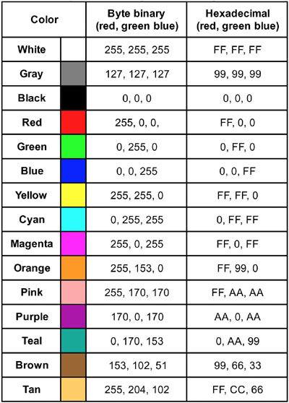
Low Level Bit Operations
C allows bit-level operations
Used extensively in binary representation of colors

Slide 13
Bitwise Operators
& - AND
| - OR
^ - XOR
~ - 1’s Compliment
<< - Left Shift
>> - Right Shift

Slide 14
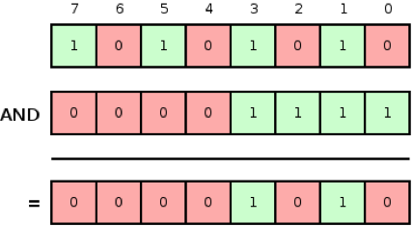
AND two bit values - &
Two bits and-ed together result in a 1 if both are 1, otherwise the result is 0
Op1 | Op2 | Result
1 | 1 | 1
1 | 0 | 0
0 | 0 | 0

Slide 15
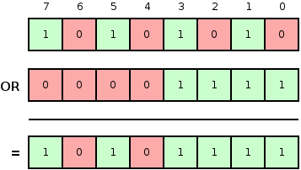
OR two bit values - |
Two bits or-ed together result in a 1 if one or both are 1, otherwise the result is 0
Op1 | Op2 | Result
1 | 1 | 1
1 | 0 | 1
0 | 0 | 0

Slide 16
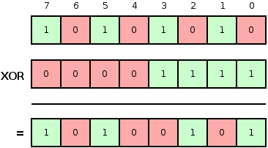
XOR two bit values - ^
Two bits xor-ed together result in a 1 only if one bit is 1, otherwise the result is 0
Op1 | Op2 | Result
1 | 1 | 0
1 | 0 | 1
0 | 0 | 0

Slide 17
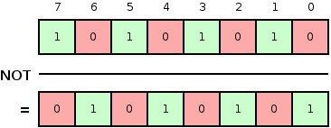
1’s Complement a bit value - ~
Inverts the bits in a value
Op1 | Result
1 | 0
0 | 1

Slide 18
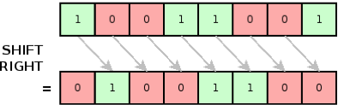
Right Shift bit values - >>
Bits are shifted right by operand 2 number of places, dropping the bits
Op1 | Op2 | Result
11 | 1 | 1
01 | 1 | 0
10 | 2 | 0

Slide 19
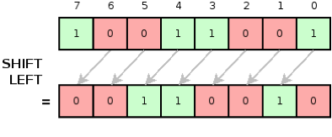
Left Shift bit values - <<
Bits are shifted left by operand 2 number of places, adding zeros
Op1 | Op2 | Result
11 | 1 | 110
01 | 1 | 010
10 | 2 | 1000

Slide 20
Classwork: Logical Operations

